Slide 1


Faculty of Computing and Informatics
Business Management Information Systems – BMC511S
Lesson 6 – Ethical, social and privacy issues in information systems

Slide 2
Faculty of Computing and Informatics
Ethical, social and privacy issues in information systems
An introduction to ethics
Five moral dimensions of the information age
Ethics principles
Information systems and privacy
Property rights and intellectual property (IP)
Examples of liability laws in information systems
Social costs of introducing information technology

Slide 3
By the end of this lesson students should be able to answer the questions:
What ethical, social, and political issues are raised by information systems?
What specific principles for conduct can be used to guide ethical decisions?
Why do contemporary information systems technology and the Internet pose challenges to the protection of individual privacy and intellectual property?
How have information systems affected laws for establishing accountability, liability, and the quality of everyday life?

Slide 4
QUESTION BLANK
One of the capabilities of Internet communication is the ability of the individual to appear essentially anonymous by using made-up user names.
e.g. bones@gmail.com desertrider@yahoo.com
Is anonymity the same thing as privacy, and should it be a right?
What ethical issues are raised by increased anonymity?

Slide 5
Faculty of Computing and Informatics
An introduction to ethics
Ethics – the principles of right and wrong that individuals use to make choices that guide their behavior
Information systems create opportunities for social change, thus threatening the distribution of power, money, rights and obligations
ICTs can be used to achieve not only social progress but to commit crimes and threaten values
Ethical issues occur in the areas of:
  Internet and commerce; assemble, integration and distribution of information
  Personal privacy; protection of intellectual property
  Accountability for the consequences of information systems
  Standards to safeguard systems quality

Slide 6
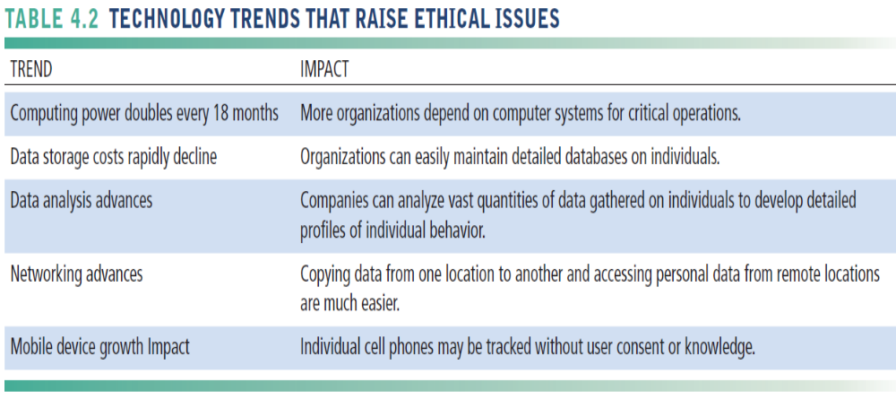

Slide 7
Faculty of Computing and Informatics
An introduction to ethics -examples
Profiling – all the ways that you generate information about yourself on Facebook, telephone calls, banking records, web site visits reveal information about you – this has privacy implications
Non-obvious relationship awareness (NORA) – hidden connections
Using ICT to reduce the size of the workforce
Monitoring employees on the internet
Social networking sites monitor subscribers and sell information to advertisers

Slide 8
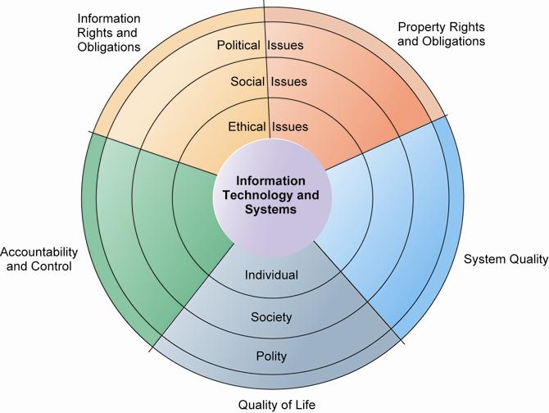
THE RELATIONSHIP AMONG ETHICAL, SOCIAL, POLITICAL ISSUES IN AN INFORMATION SOCIETY

Slide 9
Faculty of Computing and Informatics
Five moral dimensions of the information age
Information rights and obligations: What information rights do individuals and organisations possess that they can protect?
Property rights and obligations: How will intellectual property (IP) be protected in a digital society in which tracing and accounting for ownership are difficult?
Accountability and control: Who will be held accountable for harm done to individuals, collective information and property rights?
Systems quality: What standards of data and systems quality should we demand to protect individual rights and safety?
Quality of life: What values should be preserved in the knowledge society? Which institutions, cultural values and practices should be protected?

Slide 10
Faculty of Computing and Informatics
Ethics principles
The golden rule: Do unto others as you would have them do unto you
Immanuel Kant’s categorical imperative: If an action is not right for everyone to take, it is not right for anyone, e.g. if everyone did this could the organisation survive?
The slippery slope rule: If an action cannot be taken repeatedly, it is not right to take at all. An action may bring about a small change now that is acceptable, but if repeated it would bring unacceptable change in the long run
Utilitarian principle: Take action that achieves the higher or greater value
Risk aversion principle: Take action that produces the least harm or the least potential risk, e.g. building a nuclear generator in the city centre
Ethical “no free” lunch rule: compensate the creator for his work if it is useful to you

Slide 11
Faculty of Computing and Informatics
Information systems and privacy
Privacy is the claim of individuals to be left alone, free from surveillance or interference from other individuals, e.g. –information sent over internet is monitored, captured and stored
Cookies – small text files deposited on a computer hard drive that identify a visitor’s web browser software and tracks visits to the web site
Spyware – secretly installs itself on an internet user’s computer resulting in websites sending ads and unsolicited material
Opt-out model of informed consents permits the collection of personal information until consumer requests that data should not be collected
Opt-in model – businesses prohibited from collecting personal information unless the consumer specifically takes action to approve information collection

Slide 12
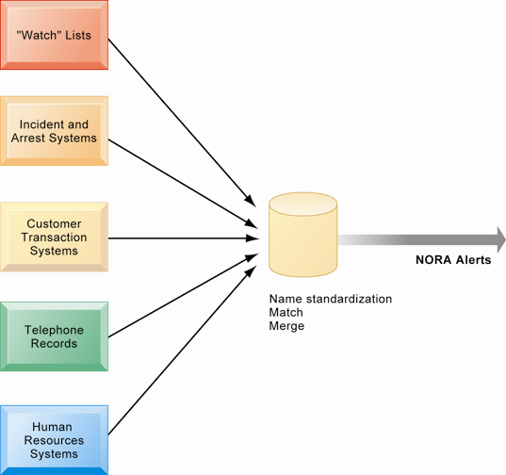
NONOBVIOUS RELATIONSHIP AWARENESS (NORA)
NORA technology can take information about people from disparate sources and find obscure, nonobvious relationships. It might discover, for example, that an applicant for a job at a casino shares a telephone number with a known criminal and issue an alert to the hiring manager.

Slide 13
Faculty of Computing and Informatics
Property rights: intellectual property (IP)
IP – intangible property created by individuals or corporations
Trade secrets – a formula, device, pattern or compilation of data – provided it is not based on information in the public domain
Copyright – Statutory grant that protects creators of IP from having their work copied by others for any purpose during the life of an author and an additional 70 years after author’s death
Patent – a patent grants the owner an exclusive monopoly of the idea behind an invention for 20 years

Slide 14
Faculty of Computing and Informatics
Information systems and liability laws - examples
If a person is injured by a machine that is controlled by software, who is liable?
Should a social networking site like Facebook be held liable for postings by users that are anti?
When credit card information is compromised and individuals or businesses are harmed, who is liable?
If an ATM fails and bank customers are inconvenienced, who is liable?

Slide 15
Faculty of Computing and Informatics
Social costs of introducing ICT
Power of centralized decision-making: decision-makers now have access to all information they require
Reduced response time to competition – Businesses no longer have time to adjust to competition – Just in time society
Family, work and leisure boundaries non-existent – work is anytime, anywhere
Dependence and vulnerability – dependence on information systems means vulnerability when they fail
Computer crime – commission of illegal acts through a computer, e.g. identity theft, fraud

Slide 16
Faculty of Computing and Informatics
Social costs of introducing ICT
Computer abuse – commission of acts involving a computer that may not be illegal but are considered unethical, e.g. spam, junk mail
Employment – Re-engineering work leading to job losses and unemployment
Equity and access – Will social, economic and cultural gaps be reduced by ICT or increased?. Poor communities are less likely to have access to computers and the internet – digital divide
Health risks – Ergonomics, radiation from computers, vison problems

Slide 17
Ethics in an information society holds each person responsible for his or her actions.
Each person is accountable for everything he or she does, no matter how anonymous the action may seem.
Each person is liable for the consequences his or her actions may inflict on other people and society as a whole.

Slide 18
13 Storch Street
Private Bag 13388
Windhoek
NAMIBIA
T: +264 61 207 2258
F: +264 61 207 9258
E: fci@nust.na
W: www.nust.na
Faculty of Computing and Informatics
Thank You.

